Slide 1
Log Ingestor and Query Interface
Anay Malviya

Slide 2
Introduction
Assignment Overview:
Creation of a robust Log Ingestor and Query Interface.
Objective: To efficiently handle vast volumes of log data and provide a user-friendly interface for querying this data.

Slide 3
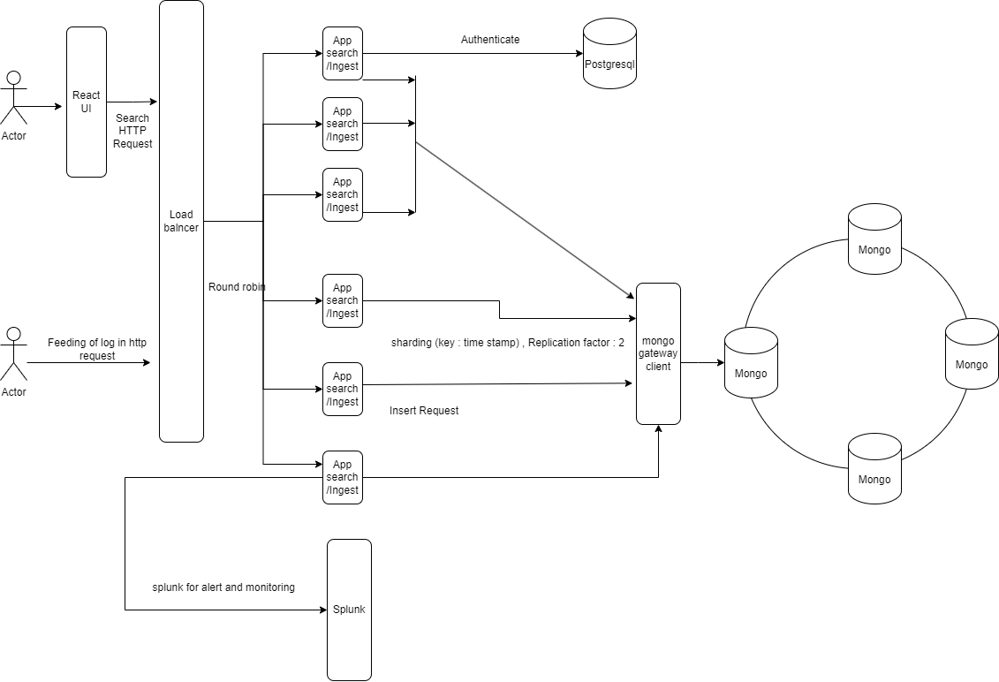
System Design

Slide 4
Features Implemented
HTTP Log Ingestion
Batch Insertion
Scalability Consideration
Error Handling
Full Text Search
Field Filters
Date Range Filter
Efficient Query Handling
Regular Expression Search

